Slide 1
Pick a Polygon
Discover Pick’s Theorem
Areas have different shapes but the same area.

Slide 2
Pick a Polygon

Slide 3
Pick a Polygon
A
B
C
a
D
E

Slide 4
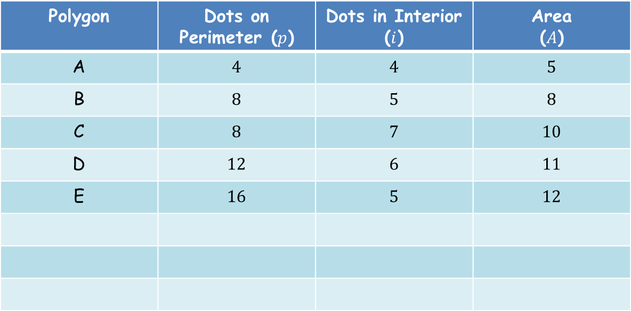
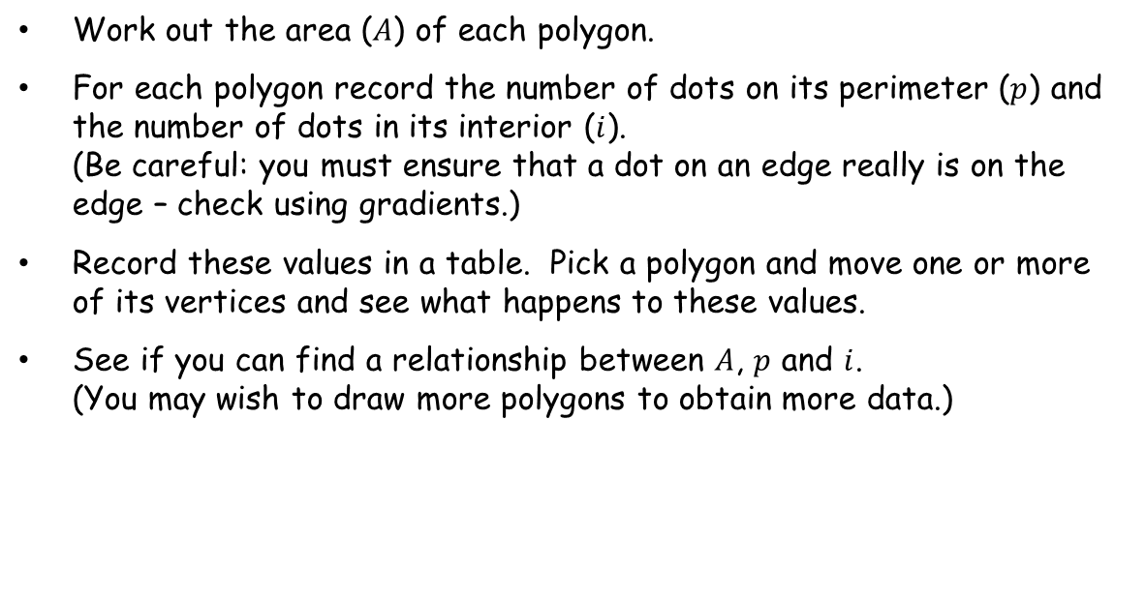
Work out the area ($A$) of each polygon.
For each polygon record the number of dots on its perimeter ($p$) and the number of dots in its interior ($i$).
(Be careful: you must ensure that a dot on an edge really is on the edge – check using gradients.)
Record these values in a table. Pick a polygon and move one or more of its vertices and see what happens to these values.
See if you can find a relationship between $A$, $p$ and $i$.
(You may wish to draw more polygons to obtain more data.)
Polygon | Dots on Perimeter ($p$) | Dots in Interior ($i$) | Area ($A$)
A | $$4$$ | $$4$$ | $$5$$
B | $$8$$ | $$5$$ | $$8$$
C | $$8$$ | $$7$$ | $$10$$
D | $$12$$ | $$6$$ | $$11$$
E | $$16$$ | $$5$$ | $$12$$

Slide 5



Let’s look at how the area changes with the number of dots on the perimeter.
$p=3, i=0$ $A=\frac{1}{2}$
$p=4, i=0$ $A=1$
$p=5, i=0$ $A=\frac{3}{2}$
We can see that this trend will continue and deduce that as the number of dots on the perimeter increases by one the area increases by one half.

Slide 6



Let’s now look at how the area changes with the number of dots in the interior.
$p=6, i=0$ $A=2$
$p=6, i=1$ $A=3$
$p=6, i=2$ $A=4$
We can see that this trend will continue and deduce that as the number of dots in the interior increases by one the area increases by one.

Slide 7



















Consolidating results:
$\frac{1}{2}p+i$
$p=3, i=0$ $A=\frac{1}{2}$
$\frac{3}{2}$
$=A+1$
$p=4, i=0$ $A=1$
$2$
$=A+1$
$p=5, i=0$ $A=\frac{3}{2}$
$\frac{5}{2}$
$=A+1$
$p=6, i=0$ $A=2$
3
$=A+1$
$p=6, i=1$ $A=3$
$4$
$=A+1$
$p=6, i=2$ $A=4$
$5$
$=A+1$
So we can deduce that a formula for the area of each polygon is:
$$A=\frac{1}{2}p+i−1$$
Note: although we can feel confident about this formula we have not proved it.

Slide 8
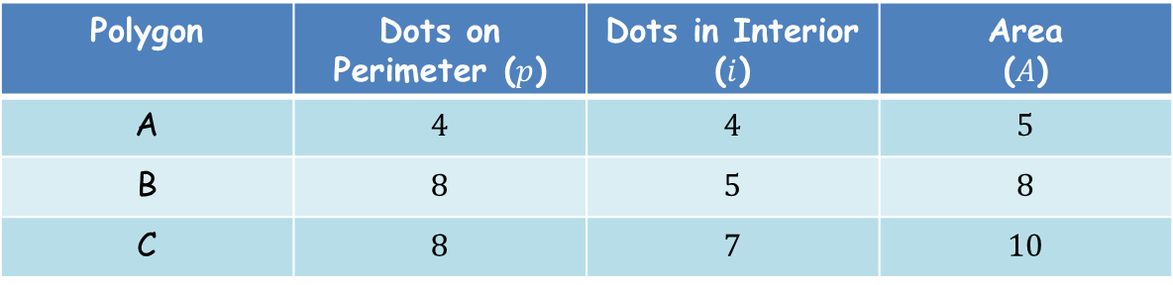

Or, you could decide that there may be a linear relationship between the quantities and investigate by solving some simultaneous equations.
Let’s assume $ap+bi+c=A$ and form equations from the first three results:
$4a+4b+c=5$ (1)
$8a+5b+c=8$ (2)
$8a+7b+c=10$ (3)
Polygon | Dots on Perimeter ($p$) | Dots in Interior ($i$) | Area ($A$)
A | $$4$$ | $$4$$ | $$5$$
B | $$8$$ | $$5$$ | $$8$$
C | $$8$$ | $$7$$ | $$10$$

Slide 9
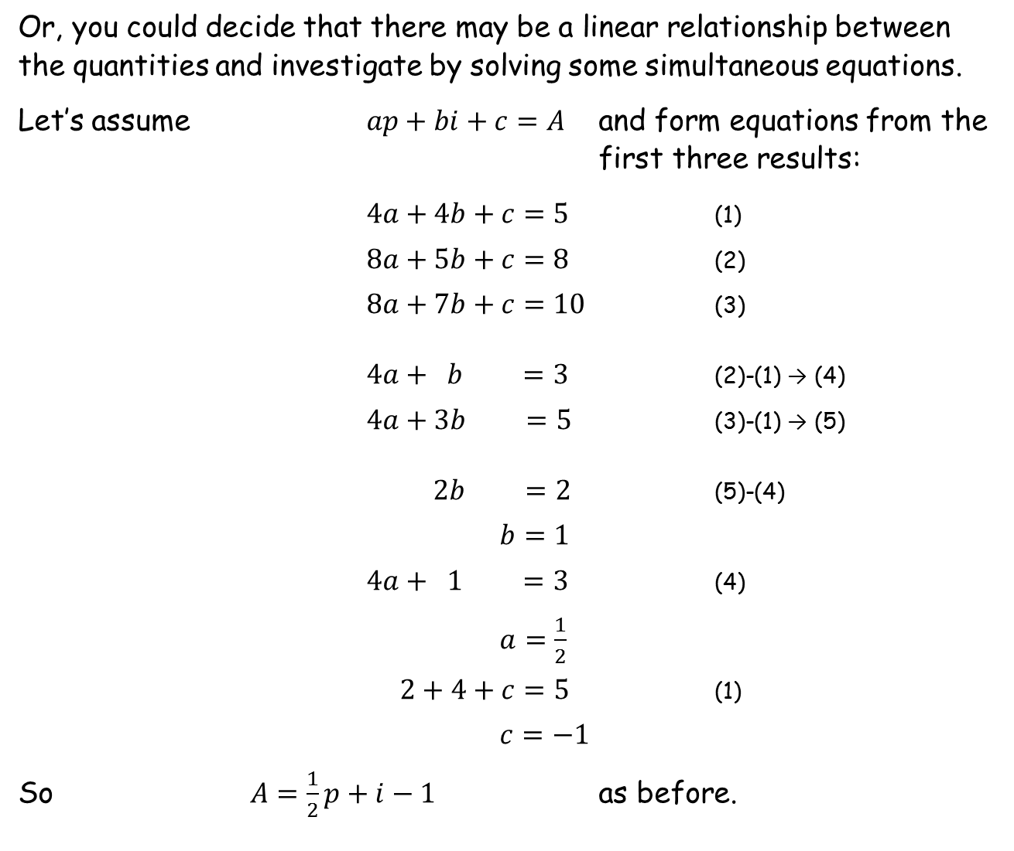
Or, you could decide that there may be a linear relationship between the quantities and investigate by solving some simultaneous equations.
Let’s assume $ap+bi+c=A$ and form equations from the first three results:
$4a+4b+c=5$ (1)
$8a+5b+c=8$ (2)
$8a+7b+c=10$ (3)
$4a+ b =3$ (2)-(1) → (4)
$4a+3b =5$ (3)-(1) → (5)
$2b =2$ (5)-(4)
$b=1$
$4a+ 1 =3$ (4)
$a=\frac{1}{2}$
$2+4+c=5$ (1)
$c=−1$
So $A=\frac{1}{2}p+i−1$ as before.

Slide 10
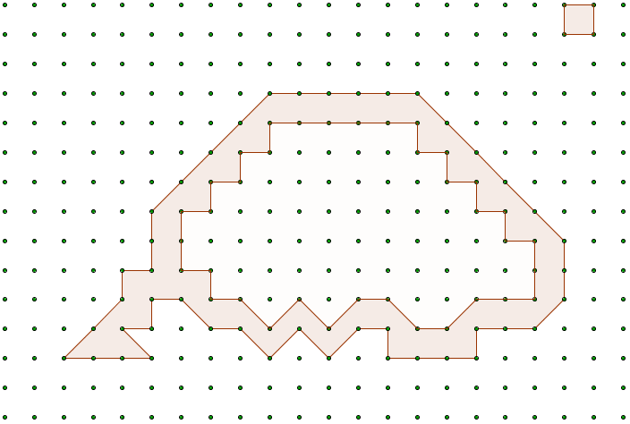
Pick a Polygon
Key:
= 1
The polygons shown go through 80 Points. What is the value of the shaded area?

Slide 11
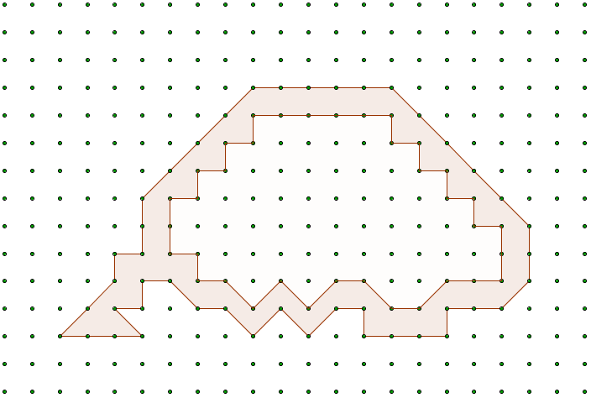

Pick a Polygon
Add an edge, as shown, forming a single polygon with two sides that happen to overlap.
This makes no difference to the area and the equation remains valid.
But we have added two extra points on the perimeter. There are no interior points.
So area = $\frac{1}{2}\left(80+2\right)+0−1=40$.
The polygons shown go through 80 Points. What is the value of the shaded area?
Notes:
44 outside, 36 inside, so 80 in total. Add an edge to make 82. Area = 0.5*82 – 1 = 40.

Slide 13
Note to Teacher
There are 6 different versions of the worksheet in the pdf file.
6 copies of the shaded area question are also provided in the pdf file.
So printing the complete pdf file gives you everything you need for 6 pupils.

Slide 14
RESOURCES

Slide 15
SIC_43
Pick a Polygon
A
B
C
a
D
E

Slide 16
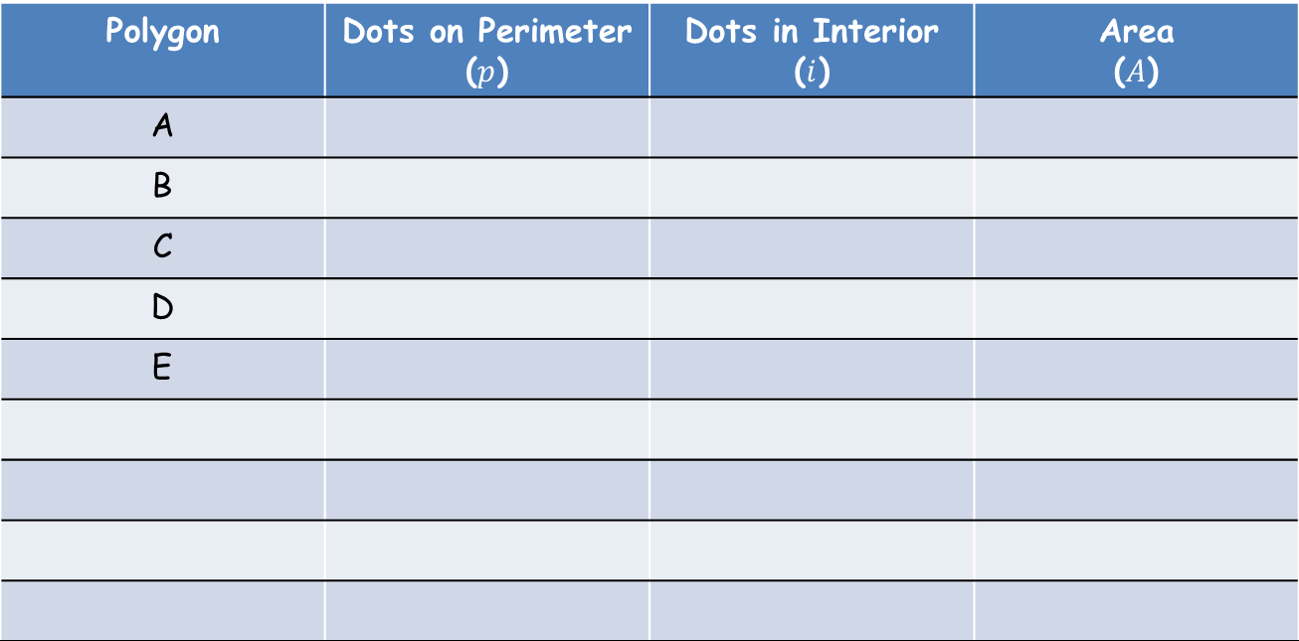
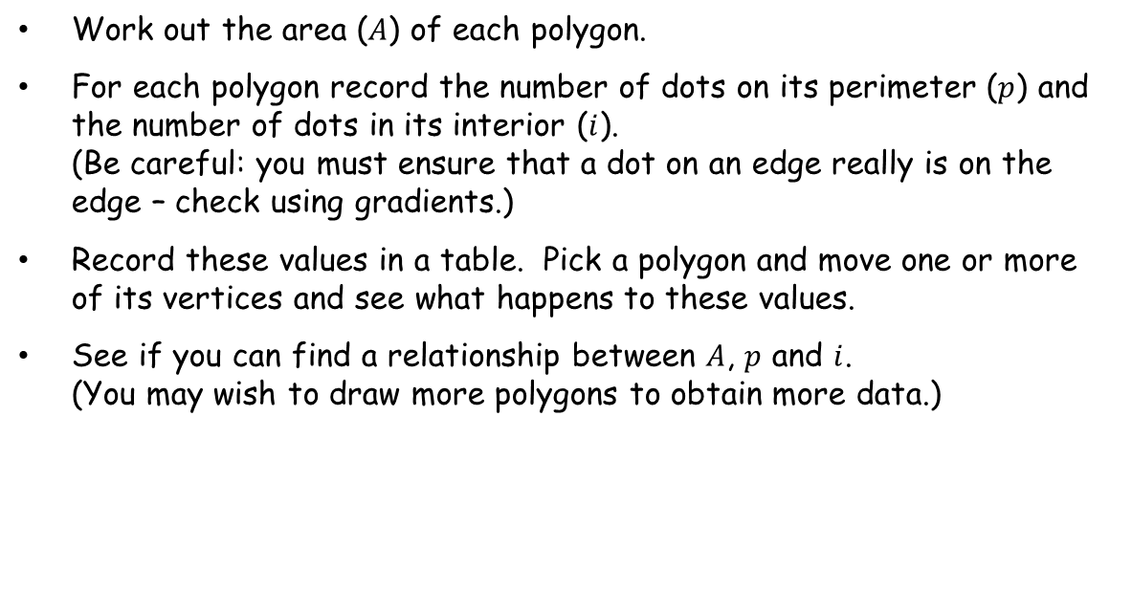
Work out the area ($A$) of each polygon.
For each polygon record the number of dots on its perimeter ($p$) and the number of dots in its interior ($i$).
(Be careful: you must ensure that a dot on an edge really is on the edge – check using gradients.)
Record these values in a table. Pick a polygon and move one or more of its vertices and see what happens to these values.
See if you can find a relationship between $A$, $p$ and $i$.
(You may wish to draw more polygons to obtain more data.)
Polygon | Dots on Perimeter ($p$) | Dots in Interior ($i$) | Area ($A$)
A
B
C
D
E

Slide 17
SIC_43
Pick a Polygon
A
B
C
D
b
E

Slide 18
Work out the area ($A$) of each polygon.
For each polygon record the number of dots on its perimeter ($p$) and the number of dots in its interior ($i$).
(Be careful: you must ensure that a dot on an edge really is on the edge – check using gradients.)
Record these values in a table. Pick a polygon and move one or more of its vertices and see what happens to these values.
See if you can find a relationship between $A$, $p$ and $i$.
(You may wish to draw more polygons to obtain more data.)
Polygon | Dots on Perimeter ($p$) | Dots in Interior ($i$) | Area ($A$)
A
B
C
D
E

Slide 19
SIC_43
Pick a Polygon
A
B
C
D
c
E

Slide 20
Work out the area ($A$) of each polygon.
For each polygon record the number of dots on its perimeter ($p$) and the number of dots in its interior ($i$).
(Be careful: you must ensure that a dot on an edge really is on the edge – check using gradients.)
Record these values in a table. Pick a polygon and move one or more of its vertices and see what happens to these values.
See if you can find a relationship between $A$, $p$ and $i$.
(You may wish to draw more polygons to obtain more data.)
Polygon | Dots on Perimeter ($p$) | Dots in Interior ($i$) | Area ($A$)
A
B
C
D
E

Slide 21
SIC_43
Pick a Polygon
A
B
C
D
d
E

Slide 22
Work out the area ($A$) of each polygon.
For each polygon record the number of dots on its perimeter ($p$) and the number of dots in its interior ($i$).
(Be careful: you must ensure that a dot on an edge really is on the edge – check using gradients.)
Record these values in a table. Pick a polygon and move one or more of its vertices and see what happens to these values.
See if you can find a relationship between $A$, $p$ and $i$.
(You may wish to draw more polygons to obtain more data.)
Polygon | Dots on Perimeter ($p$) | Dots in Interior ($i$) | Area ($A$)
A
B
C
D
E

Slide 23
SIC_43
Pick a Polygon
A
B
C
D
e
E

Slide 24
Work out the area ($A$) of each polygon.
For each polygon record the number of dots on its perimeter ($p$) and the number of dots in its interior ($i$).
(Be careful: you must ensure that a dot on an edge really is on the edge – check using gradients.)
Record these values in a table. Pick a polygon and move one or more of its vertices and see what happens to these values.
See if you can find a relationship between $A$, $p$ and $i$.
(You may wish to draw more polygons to obtain more data.)
Polygon | Dots on Perimeter ($p$) | Dots in Interior ($i$) | Area ($A$)
A
B
C
D
E

Slide 25
SIC_43
Pick a Polygon
A
B
C
D
f
E

Slide 26
Work out the area ($A$) of each polygon.
For each polygon record the number of dots on its perimeter ($p$) and the number of dots in its interior ($i$).
(Be careful: you must ensure that a dot on an edge really is on the edge – check using gradients.)
Record these values in a table. Pick a polygon and move one or more of its vertices and see what happens to these values.
See if you can find a relationship between $A$, $p$ and $i$.
(You may wish to draw more polygons to obtain more data.)
Polygon | Dots on Perimeter ($p$) | Dots in Interior ($i$) | Area ($A$)
A
B
C
D
E

Slide 27
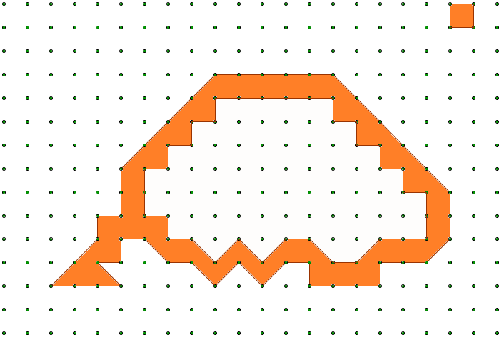
SIC_43
Pick a Polygon
Key:
= 1
The polygons shown go through 80 Points. What is the value of the shaded area?
Notes:
44 outside, 36 inside, so 80 in total. Add an edge to make 82. Area = 0.5*82 – 1 = 40.

Slide 28
SIC_43
Pick a Polygon
Key:
= 1
The polygons shown go through 80 Points. What is the value of the shaded area?
Notes:
44 outside, 36 inside, so 80 in total. Add an edge to make 82. Area = 0.5*82 – 1 = 40.

Slide 29
SIC_43
Pick a Polygon
Key:
= 1
The polygons shown go through 80 Points. What is the value of the shaded area?
Notes:
44 outside, 36 inside, so 80 in total. Add an edge to make 82. Area = 0.5*82 – 1 = 40.

Slide 30
SIC_43
Pick a Polygon
Key:
= 1
The polygons shown go through 80 Points. What is the value of the shaded area?
Notes:
44 outside, 36 inside, so 80 in total. Add an edge to make 82. Area = 0.5*82 – 1 = 40.

Slide 31
SIC_43
Pick a Polygon
Key:
= 1
The polygons shown go through 80 Points. What is the value of the shaded area?
Notes:
44 outside, 36 inside, so 80 in total. Add an edge to make 82. Area = 0.5*82 – 1 = 40.

Slide 32
SIC_43
Pick a Polygon
Key:
= 1
The polygons shown go through 80 Points. What is the value of the shaded area?
Notes:
44 outside, 36 inside, so 80 in total. Add an edge to make 82. Area = 0.5*82 – 1 = 40.

Slide 33
SOURCE

Slide 34
PROOF
There is a decent proof in Wikipedia:
https://en.wikipedia.org/wiki/Pick%27s_theorem

Slide 35
Pick a Polygon
(4,4)…5

Slide 36
Pick a Polygon
(8,5)…8

Slide 37
Pick a Polygon
(8,7)…10

Slide 38
Pick a Polygon
(12,6)…11

Slide 39
Pick a Polygon
(16,5)…12

